Slide 1
The role of cognitive biases in sustaining bad science
Dorothy V. M. Bishop
Professor of Developmental Neuropsychology
University of Oxford
@deevybee

Slide 2
Academy of Medical Sciences, 2015
Report on Reproducibility and Reliability of Biomedical Research
Need to change
incentives
Possible solutions:
Emphasis on both bottom-up and top-down changes
Data dredging
Omitting null results
Weak experimental design
Underspecified methods
Errors (e.g. faulty equipment)
Underpowered studies
Need better training in methods

Slide 3
Cognitive constraints that can make it hard to do science well
Seeing patterns in noise
Systematic misunderstanding of probability
Schemata: Need for narrative
Asymmetric moral judgements
Confirmation bias: selective attention/memory

Slide 4
Cognitive constraints that can make it hard to do science well
Seeing patterns in noise
Systematic misunderstanding of probability
Schemata: Need for narrative
Asymmetric moral judgements
Confirmation bias: selective attention/memory

Slide 5
Data analysis
Why is p-hacking so common?

Slide 6
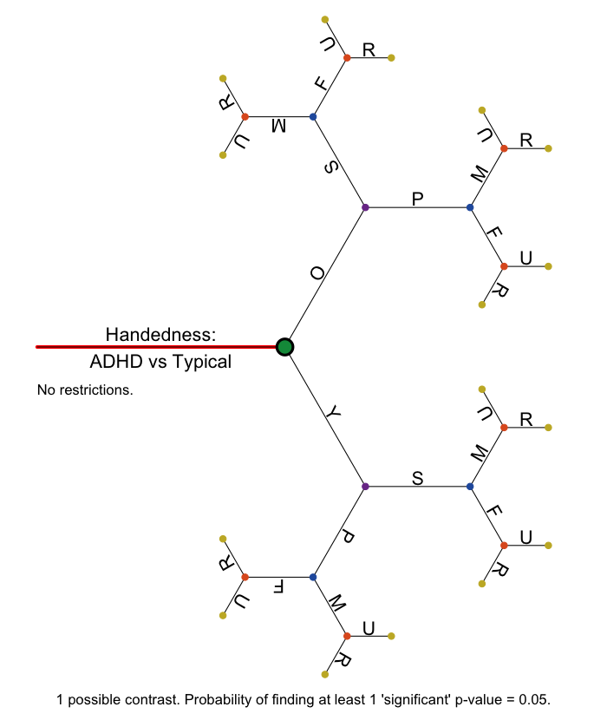
Large population database used to explore link between ADHD and handedness
1 contrast
Probability of a
‘significant’ p-value
< .05 = .05
https://figshare.com/articles/The_Garden_of_Forking_Paths/2100379

Slide 7
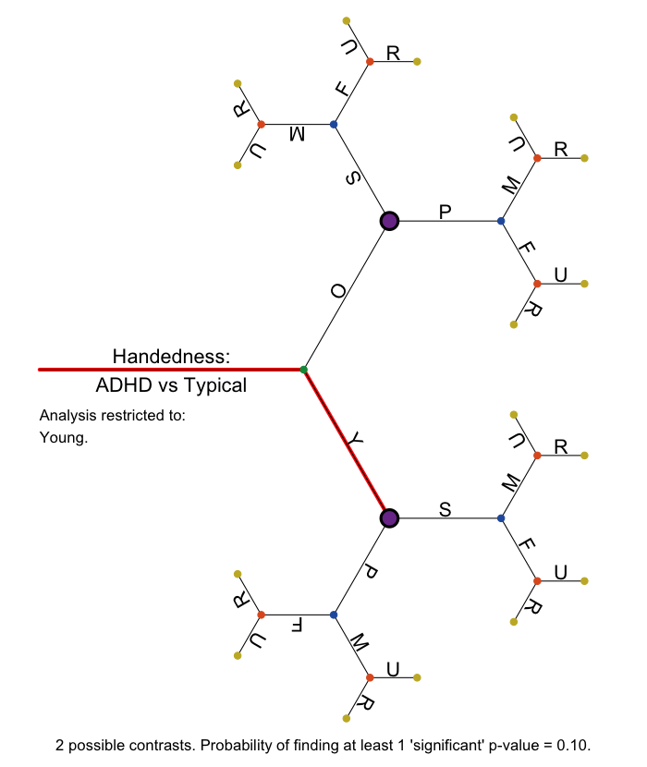
Large population database used to explore link between ADHD and handedness
Focus just on Young subgroup:
2 contrasts at this level
Probability of at least one ‘significant’ p-value < .05 under null hypothesis computed as 1 minus probability of NO significant result, i.e. 1 - .95^2 = .10
NB. If I had predicted this specific association, then probability = .05.
Problem arises if I am happy with ANY significant association!

Slide 8
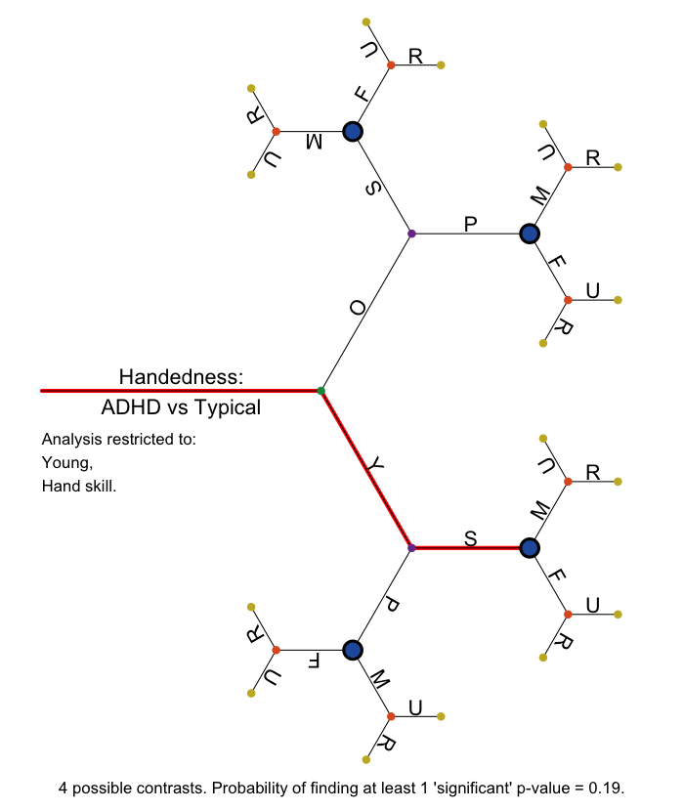
Large population database used to explore link between ADHD and handedness
Focus just on Young on
measure of hand skill:
4 contrasts at this level
Probability of at least one
‘significant’ p-value < .05
= .19

Slide 9
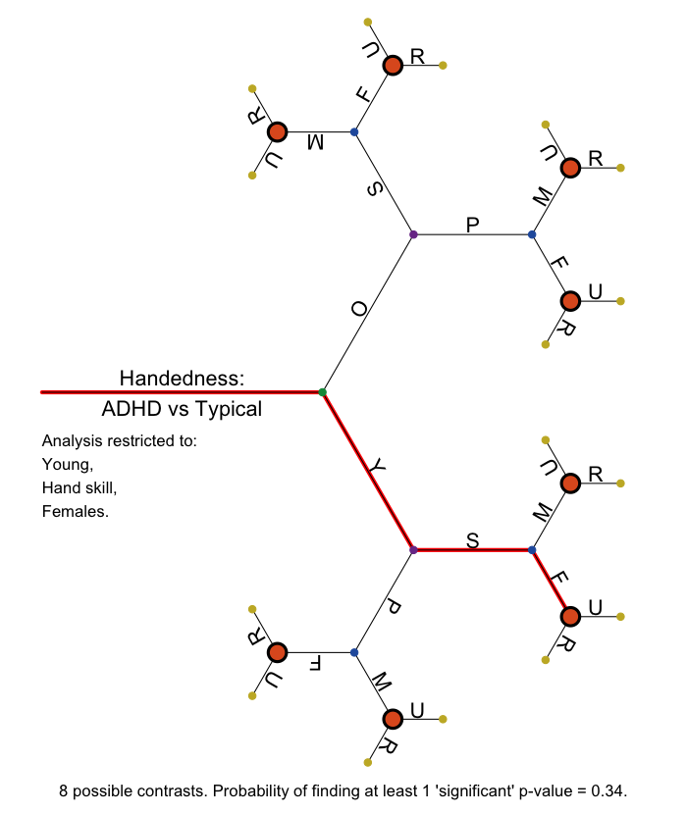
Large population database used to explore link between ADHD and handedness
Focus just on Young, Females on
measure of hand skill:
8 contrasts at this level
Probability of at least one
‘significant’ p-value < .05
= .34

Slide 10
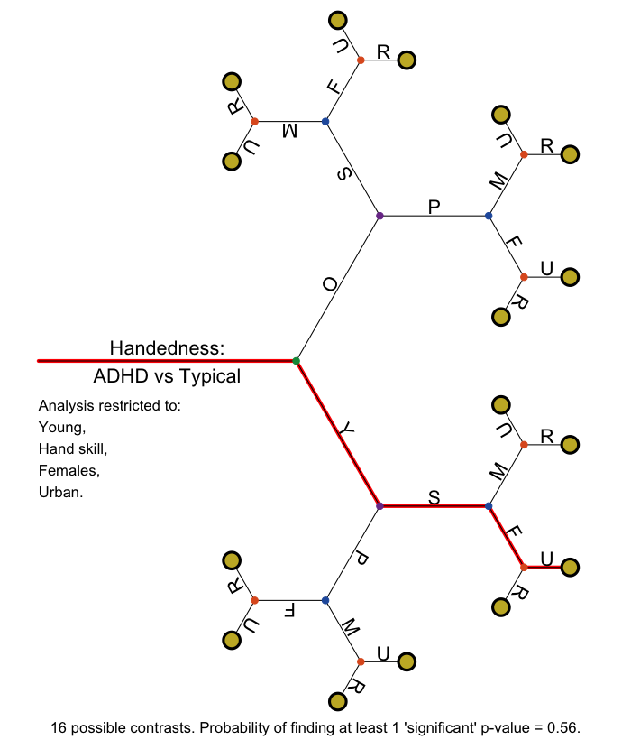
Large population database used to explore link between ADHD and handedness
Focus just on Young, Urban, Females on measure of hand skill:
16 contrasts at this level
If no a priori prediction, then the relevant value to compute is the probability of
at least one ‘significant’ p-value < .05 = .56

Slide 11
Falsification and selective reporting (p-hacking) in science
% moral judgements endorsed by members of public (N = 406)
 | Falsification | Selective reporting
Morally unacceptable | 96 | 71
Should be fired | 96 | 63
Should receive funding ban | 93 | 73
Should be a crime | 66 | 37
Pickett, J. T., & Roche, S. P. (2018). Questionable, objectionable or criminal? Public opinion on data fraud and selective reporting in science. Science and Engineering Ethics, 24(1). doi:10.1007/s11948-017-9886-2

Slide 12
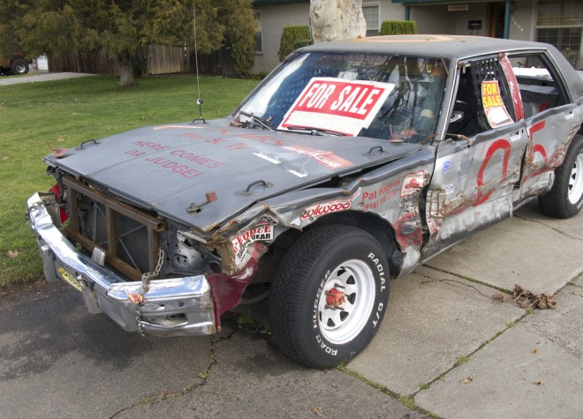
Errors of omission vs commission in studies of negotiation by Rogers et al (2016)
Lying (untrue statement)
Omission of relevant information
Stating something that is true, but in a misleading way (paltering)
Omission of information seen as dishonest, but more acceptable than lying
Honesty judgement
5%
23%
32%
Rogers, T., Zeckhauser, R., Gino, F., Norton, M. I., & Schweitzer, M. E. (2017). Artful paltering: The risks and rewards of using truthful statements to mislead others. Journal of Personality and Social Psychology, 112(3), 456-473.

Slide 13
Errors of omission vs commission in studies of negotiation by Rogers et al (2016)
Lying (untrue statement)
Omission of relevant information
Stating something that is true, but in a misleading way (paltering)
Omission of information seen as dishonest, but more acceptable than lying
Honesty judgement
5%
23%
32%
P-hacking has features of paltering.
Doesn’t involve changing data: you report what SPSS gives you!
If you don’t understand probability, may seem innocuous
- More like jaywalking than burglary!

Slide 14
Confirmation bias

Slide 15
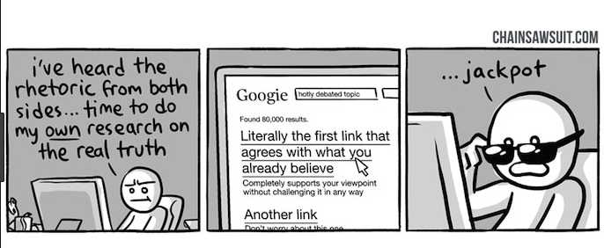
Cherry-picking as confirmation bias
We find it easier to process and remember information that agrees with our viewpoint

Slide 16
Twin studies of Developmental Language Disorder
A personal example:
Suppressed memory of relevant research, when it does not fit
Twin concordance points to genetic influence when
MZ > DZ
probandwise
concordance:
same-sex twins
MZ DZ
Lewis & Thompson, 1992 .86 .48
Bishop et al, 1995 .70 .46
Tomblin & Buckwalter, 1998 .96 .69
Hayiou-Thomas et al, 2005 .36 .33

Slide 17
Twin studies of DLD
A personal example:
Suppressed memory of relevant research, when it does not fit
Twin concordance points to genetic influence when
MZ > DZ
probandwise
concordance:
same-sex twins
MZ DZ
Lewis & Thompson, 1992 .86 .48
Bishop et al, 1995 .70 .46
Tomblin & Buckwalter, 1998 .96 .69
Hayiou-Thomas et al, 2005 .36 .33
I failed to mention this in talks for several years – I literally forgot about it!

Slide 18
Example of paltering in a literature review
Example: Study published in 2013
“Regardless of etiology, cerebellar neuropathology commonly occurs in autistic individuals. Cerebellar hypoplasia and reduced cerebellar Purkinje cell numbers are the most consistent neuropathologies linked to autism [8, 9, 10, 11, 12, 13]. MRI studies report that autistic children have smaller cerebellar vermal volume in comparison to typically developing children [14].”

Slide 19
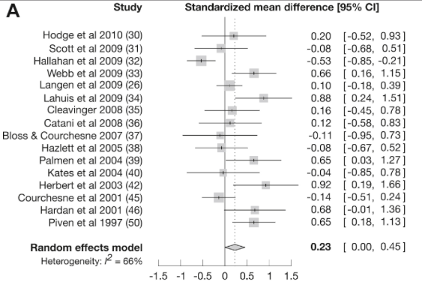
Meta-analysis: Traut et al (2018) https://doi.org/10.1016/j.biopsych.2017.09.029
Standardized mean difference is +ve when cerebellar volume is greater in ASD
Webb et al did find area of vermis smaller in ASD after covarying cerebellum size

Slide 20
Just as with reporting of results, omission/paltering in reporting the literature is not seen as serious
Can be unintentional – hard to establish blame
Need to tell ‘a good story’ in limited space
Social pressures (‘everyone is doing it’)

Slide 21
Just as with reporting of results, omission/paltering in reporting the literature is not seen as serious
Can be unintentional – hard to establish blame
Need to tell ‘a good story’ in limited space
Social pressures (‘everyone is doing it’)
Impossible to read everything
No obvious victims
Impact assumed to be small

Slide 22
Biased reporting:
How big is the effect?

Slide 23
Consider a series of experiments testing effectiveness of a treatment Y = significant difference in favour of treatment (T ) N = nonsignificant difference between T and control Alpha = .05: probability of Y when T has no effect = .05 probability of N when T has no effect = .95 Power = .8 probability of Y when T is effective = .80 probability of N when T is effective = .20 At the outset, you think T has a 50:50 chance of working What would you conclude from this series of results: Y N Y N N Y

Slide 24
When sequence of 'significant' results is Y N Y N N Y
1.
Treatment very likely to be ineffective
2.
Treatment may be effective, but need more experiments to be sure
3.
Treatment very likely to be effective
Vote Trigger

Slide 25
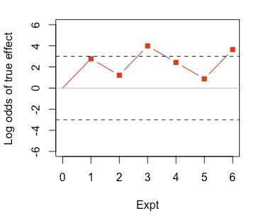
Sequence is: Y N Y N N Y
Log odds of 3 means 20 times more likely to be effective than ineffective
A: Treatment very likely to be ineffective
B: Treatment may be effective, but need more experiments to be sure
C: Treatment very likely to be effective

Slide 26
When sequence of 'significant' results is Y N N N Y N N N Y N
1.
Treatment very likely to be ineffective
2.
Treatment may be effective, but need more experiments to be sure
3.
Treatment very likely to be effective
Vote Trigger

Slide 27
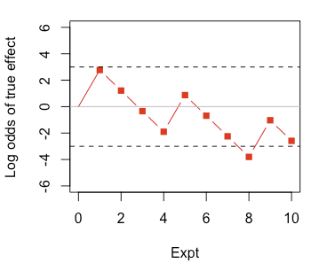
Sequence is: Y N N N Y N N N Y N
Trials in red not reported/not cited
A: Treatment very likely to be ineffective
B: Treatment may be effective, but need more experiments to be sure
C: Treatment very likely to be effective

Slide 28
Sequence is: Y N N N Y N N N Y N
Trials in red not reported/not cited
A: Treatment very likely to be ineffective
B: Treatment may be effective, but need more experiments to be sure
C: Treatment very likely to be effective

Slide 29
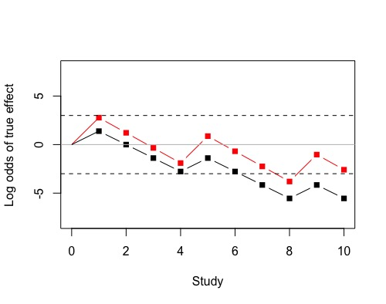
Sequence is: Y N N N Y N N N Y N
Black line shows situation when p-hacking used, so that
effective alpha is .2 rather than .05
A: Treatment very likely to be ineffective
B: Treatment may be effective, but need more experiments to be sure
C: Treatment very likely to be effective

Slide 30
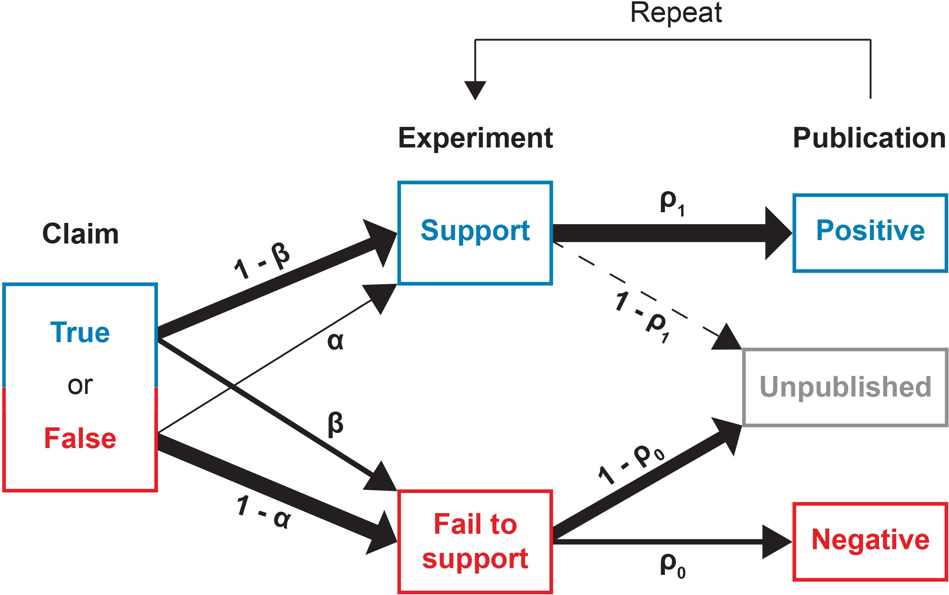
Silas Boye Nissen, Tali Magidson, Kevin Gross, Carl T Bergstrom

Slide 31
Silas Boye Nissen, Tali Magidson, Kevin Gross, Carl T Bergstrom
Or citation!

Slide 32
Inheritance of bias
When we read a peer-reviewed paper, we tend to trust the citations that back up a point
When we come to write our own paper, we cite the same materials
A good scientist won’t cite papers without reading them, but even this won’t save you from bias – you inherit it from prior papers
If prior papers only cite studies agreeing with a viewpoint, that viewpoint gets entrenched
You won’t know – unless you explicitly search – that there are other studies that give a different picture

Slide 33
So errors of omission/paltering in reviews can have serious cumulative effects – false ‘canonization’ of facts
Overlooked victims:
General public
Esp. potential users of research (patients, etc)
Researchers trying to build on results
Funders

Slide 34
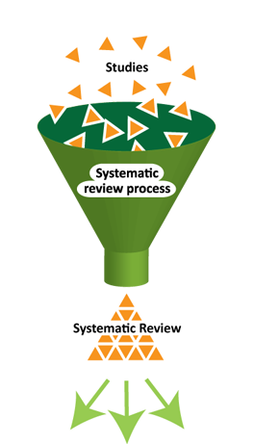
The (partial) solution from clinical trials
Always start work in a new area with a systematic review
Systematic review
Collecting and summarise all empirical evidence that fits pre-specified eligibility criteria to address a specific question
But relevant studies found by searching titles and abstracts. These tend to mention only positive results!

Slide 35
Classic p-hacking
Study looked at association with autism for many “occupational exposures” for both parents, and found none survived Bonferroni correction.
Abstract just reported the one result that was “significant”
A systematic review of other substances (e.g. pesticides) would not find the null results from this study when screening Abstracts

Slide 36
Academy of Medical Sciences, 2015
Report on Reproducibility and Reliability of Biomedical Research
Need to change
incentives
Data dredging
Omitting null results
Weak experimental design
Underspecified methods
Errors (e.g. faulty equipment)
Underpowered studies
Need better training in methods

Slide 37
What’s missing?
How humans think & reason
Need to change
incentives
Data dredging
Omitting null results
Weak experimental design
Underspecified methods
Errors (e.g. faulty equipment)
Underpowered studies
Find ways to counteract cognitive
biases
Need better training in methods

Slide 38
Thank you for listening!
Longer written version:
https://psyarxiv.com/hnbex/
Other slideshows: https://www.slideshare.net/deevybishop
Blogposts: http://deevybee.blogspot.com/2012/11/
bishopblog-catalogue-updated-24th-nov.html
Professor Dorothy Bishop
Department of Experimental Psychology,
Anna Watts Building,
Woodstock Road,
Oxford, OX2 6GG.
@deevybee

